Slide 1

CSE 411 Simulation & Modeling
Discrete Event Simulation

Slide 2
Discrete Event Simulation
State variables change instantaneously at different point in time
Can change only at a countable number of points in time
Event occurs at those points
Event may change the state of a system

Slide 3



Single Server Queue
Waiting Customer
Server
Arrival
Departure

Slide 4
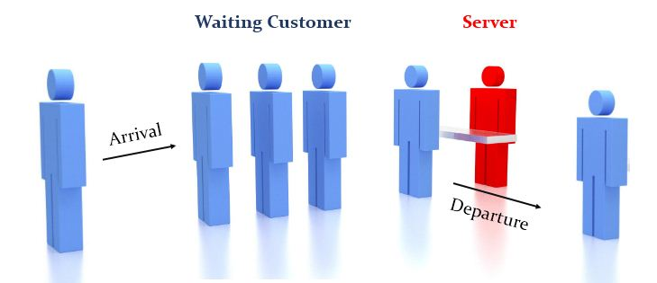
Single Server Queue
Estimate the average delay in queue
for an arriving customer.
Analytic Solution exists for simple
case, but in real life there can be
different complexity.

Slide 5
Single Server Queue: State Variables
Status of Server
To determine upon a customer’s arrival, whether the customer can be served or must join in the queue
Number of customers waiting in the queue
To determine after completing service to a customer, whether the server become idle or start serving the first customer in the queue
Time of arrival of each person waiting in queue
To computer delay

Slide 6
Single Server Queue: Events
Arrival of a customer
Status of Server can be changed from IDLE to BUSY
Number of Customers in Queue can be incremented by 1
Service completion (and departure) of a customer
Status of Server can be changed from BUSY to IDLE
Number of Customers in Queue can be decremented by 1
There may be some events that do not change state variables
End of Simulation

Slide 7
Simulation Clock
We need to-
Keep track of current value of simulated time
Mechanism to advance simulated time from one value to another
We maintain a simulation_clock
Unit is not explicitly stated, same as input parameters
No relationship between simulated time and time needed to run the simulation on the computer

Slide 8
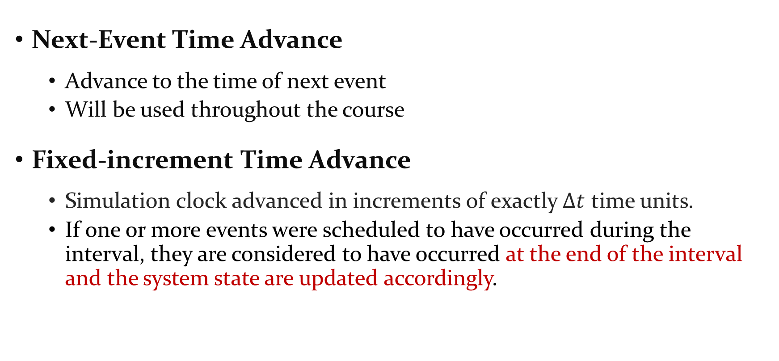
Time Advance Mechanisms
Next-Event Time Advance
Advance to the time of next event
Will be used throughout the course
Fixed-increment Time Advance
Simulation clock advanced in increments of exactly $Δt$ time units.
If one or more events were scheduled to have occurred during the interval, they are considered to have occurred at the end of the interval and the system state are updated accordingly.

Slide 9


Fixed-Increment Time Advance
Calculation is done after a fixed time ($∆t$)

Slide 10
Next-Event Time Advance
Initialize simulation clock to 0
Determine times of occurrence of future events – event list
Clock advances to next (most imminent) event, which is executed
Event execution may involve updating event list (Adding new event)
Continue until stopping rule is satisfied (must be explicitly stated)
Clock “jumps” from one event time to the next, and doesn’t “exist” for times between successive events … periods of inactivity are ignored

Slide 11
Next-Event Time Advance
Notations for Single Server Queue:
t_{i} = time of arrival of ith customer (t₀ = 0)
A_{i} = t_{i} – t_{i-1} = interarrival time between (i-1)st and ith customers (usually assumed to be a random variable from some probability distribution F_{A})
S_{i} = service-time requirement of ith customer (another random variable F_{S})
D_{i} = delay in queue of ith customer
C_{i} = t_{i} + D_{i} + S_{i} = time ith customer completes service and departs
e_{j} = time of occurrence of the jth event (of any type), j = 1, 2, 3, …

Slide 12
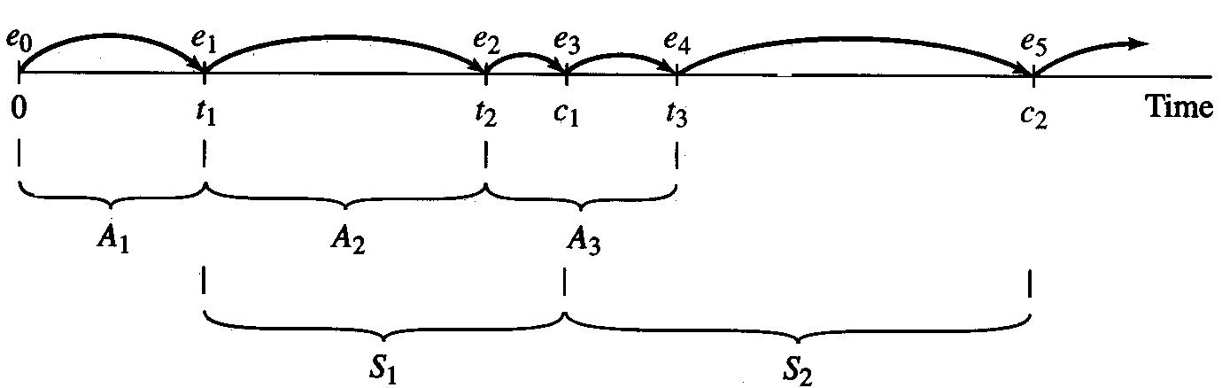
Single Server Queue

Slide 13
Components and Organization of DES
Data Structures
System State – variables to describe state
Simulation Clock – current value of simulated time
Event List - List containing the next times of the future events
Statistical Counters - Variables used for storing statistical information about System performance

Slide 14
Components and Organization of DES
Routines
Initialization routine – initialize model at time 0
Timing routine – determine next event time, type; advance clock
Event routines – carry out logic for each event type
Library routines – utility routines to generate random variates, etc.
Report generator – to summarize, report results at end
Main program – ties routines together, executes them in right order

Slide 15
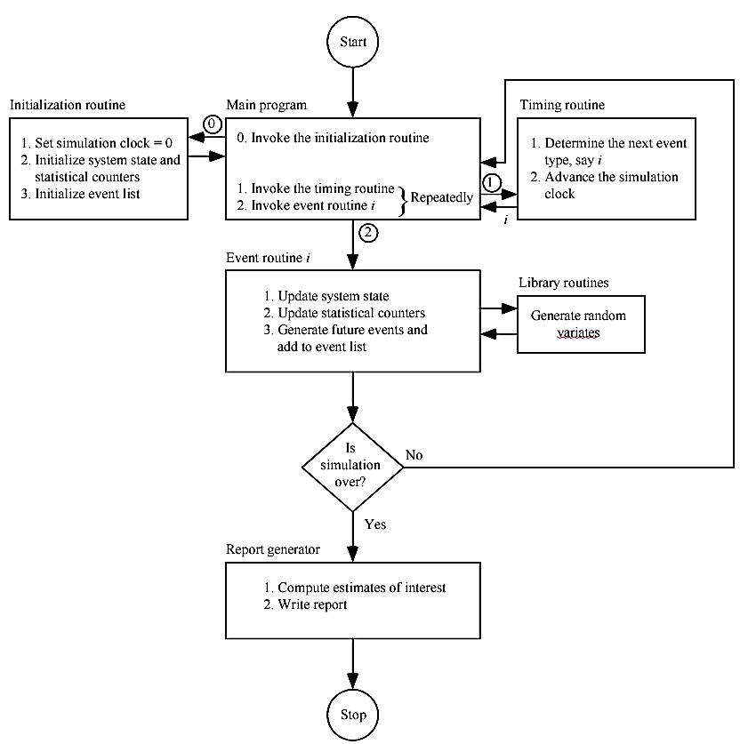

Slide 16
Reference
Simulation Modeling and Analysis by Averill M Law (Fourth Edition)
Chapter 1 (1.3, Appendix 1.A)

Slide 17
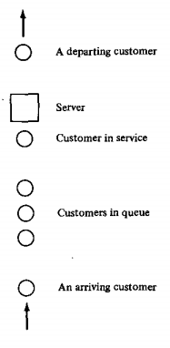
SIMULATION OF A SINGLE-SERVER QUEUEING SYSTEM
Known Input values:
Arrival of customers – IID random variables
Service-time – IID random variables
Events :
Arrival of a customer
Departure of a customer

Slide 18
SIMULATION OF A SINGLE-SERVER QUEUEING SYSTEM
Arrival of a customer
if server is idle then
-s/he enters service immediately
-his/her service time is calculated
else
-s/he joins the end of the queue
Departure of a customer
if queue is non-empty then
-server allows the first customer to go for the service (FIFO manner)
-his/her service time in calculated
else
-server remains idle

Slide 19
SIMULATION OF A SINGLE-SERVER QUEUEING SYSTEM
The Story
Simulation starts from a “empty-and-idle” state
At t=0, waiting for the first customer starts
First customer arrives after the first interarrival time A1
Simulation ends after a fixed number (n) of customers complete their delay in the queue (when n^{th} customer enters into service)
Time to end is also a random variable (depends of interarrival and service-time random variables)
Other types of ending is also possible

Slide 20
Different Random Variables
IID – Independent and Identically Distributed Random Variables
Output of two unbiased coin tosses
Events: {Head in first coin toss} and {Head in second coin toss}
Identically Distributed but not-independent
From a bag containing two balls Black and White,
Events: {First ball drawn is Black} and {Second ball drawn is Black}
Can be of other types

Slide 21
Input and Output of the simulation
Input
Interarrival Times (IID random variables)
Service Times (IID random variables)
Output
Average delay in the queue of the customers
Average number of customers in queue
Expected utilization of the server

Slide 22
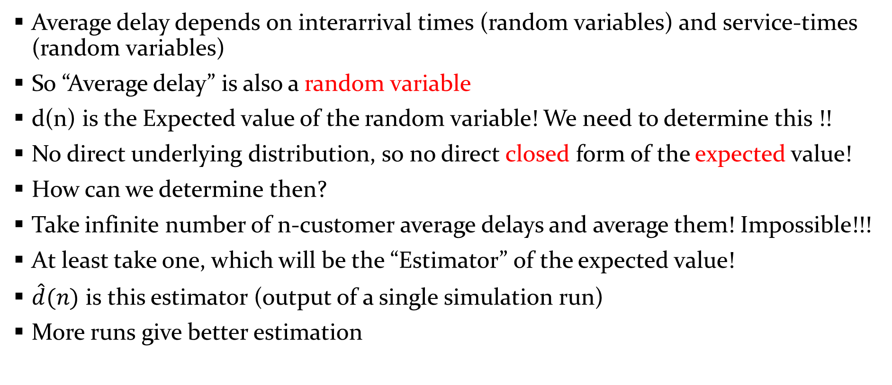
Estimating the Average Delay in the Queue
Average delay depends on interarrival times (random variables) and service-times (random variables)
So “Average delay” is also a random variable
d(n) is the Expected value of the random variable! We need to determine this !!
No direct underlying distribution, so no direct closed form of the expected value!
How can we determine then?
Take infinite number of n-customer average delays and average them! Impossible!!!
At least take one, which will be the “Estimator” of the expected value!
$\hat{d}(n)$ is this estimator (output of a single simulation run)
More runs give better estimation

Slide 23

Estimating the Average Delay in the Queue
For a single run, if the n-customer delays are D₁, D₂, …, D_{n}
$$\hat{d}\left(n\right)= \frac{\sum_{i=1}^{n}{D_{i}}}{n}$$

Slide 24
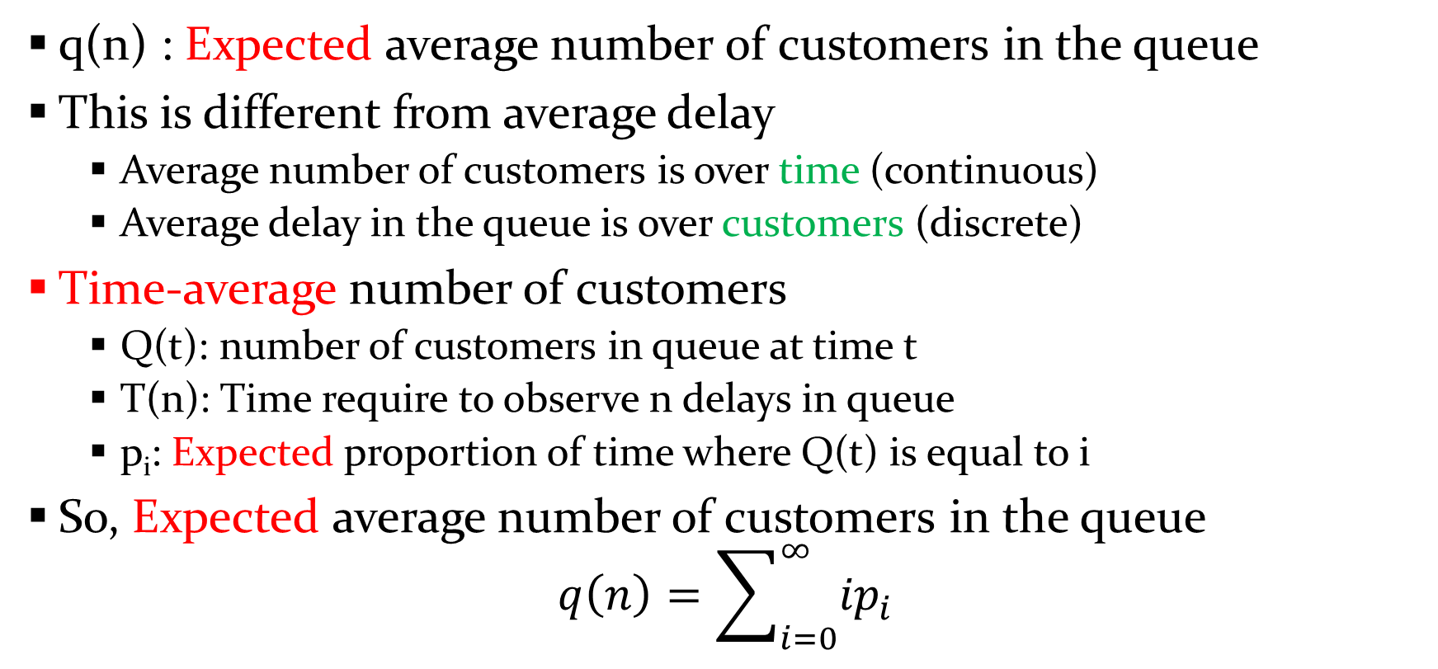
Estimating the Average Number of Customers in the Queue
q(n) : Expected average number of customers in the queue
This is different from average delay
Average number of customers is over time (continuous)
Average delay in the queue is over customers (discrete)
Time-average number of customers
Q(t): number of customers in queue at time t
T(n): Time require to observe n delays in queue
p_{i}: Expected proportion of time where Q(t) is equal to i
So, Expected average number of customers in the queue
$$q\left(n\right)=\sum_{i=0}^{∞}{{ip}_{i}}$$

Slide 25
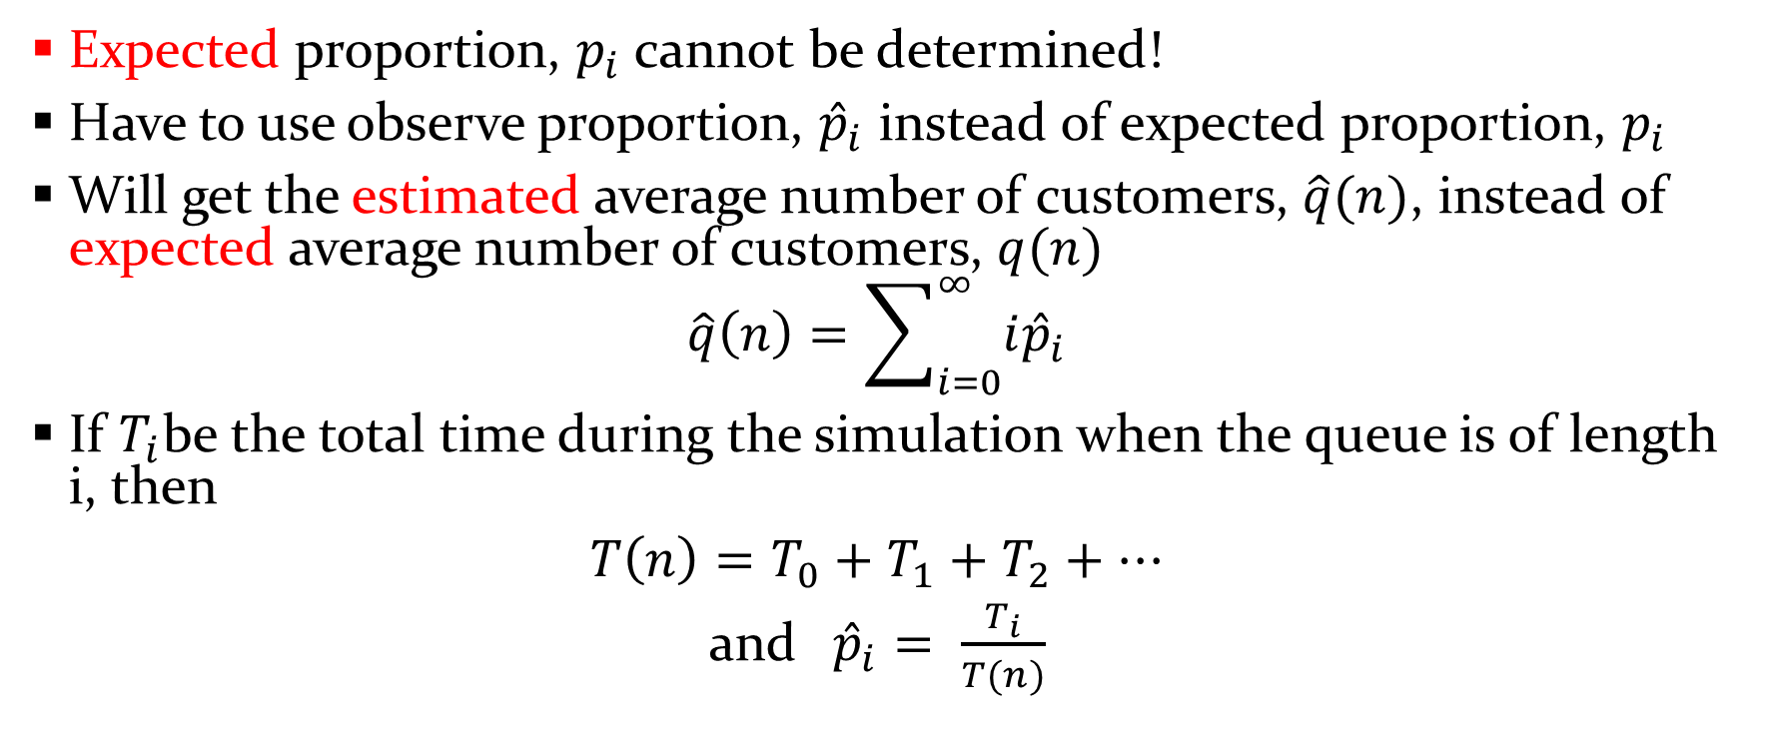
Estimating the Average Number of Customers in the Queue
Expected proportion, $p_{i}$ cannot be determined!
Have to use observe proportion, ${\hat{p}}_{i}$ instead of expected proportion, $p_{i}$
Will get the estimated average number of customers, $\hat{q}(n)$, instead of expected average number of customers, $q(n)$
$$\hat{q}\left(n\right)=\sum_{i=0}^{∞}{{i\hat{p}}_{i}}$$
If $T_{i}$be the total time during the simulation when the queue is of length i, then
$T\left(n\right)=T_{0}+T_{1}+T_{2}+…$
and${\hat{p}}_{i}= \frac{T_{i}}{T(n)}$

Slide 26

Estimating the Average Number of Customers in the Queue
So the estimated average number of customers would be
$$\hat{q}\left(n\right)=\frac{\sum_{i=0}^{∞}{iT_{i}}}{T(n)}$$

Slide 27
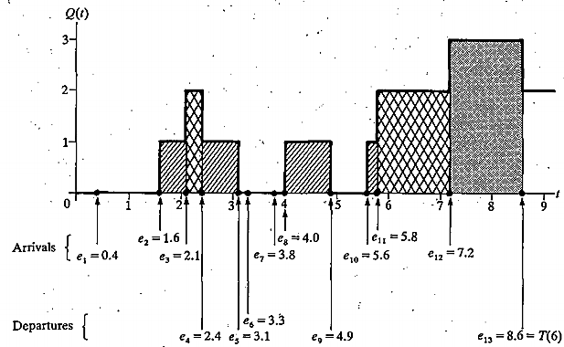
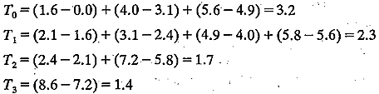
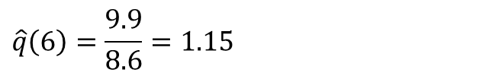
Estimating the Average Number of Customers in the Queue
Consider the sample simulation run
$$\hat{q}\left(6\right)=\frac{9.9}{8.6}=1.15$$

Slide 28
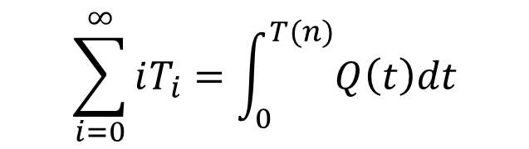
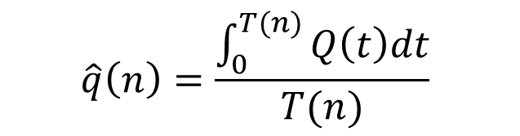
Estimating the Average Number of Customers in the Queue
Consider the sample simulation run
We are considering the area under the Q(t) curve
“Area under the curve” is an integral
$$\sum_{i=0}^{∞}{iT_{i}=\int_{0}^{T(n)}{Q\left(t\right)dt}}$$
$$\hat{q}\left(n\right)=\frac{\int_{0}^{T(n)}{Q\left(t\right)dt}}{T(n)}$$

Slide 29
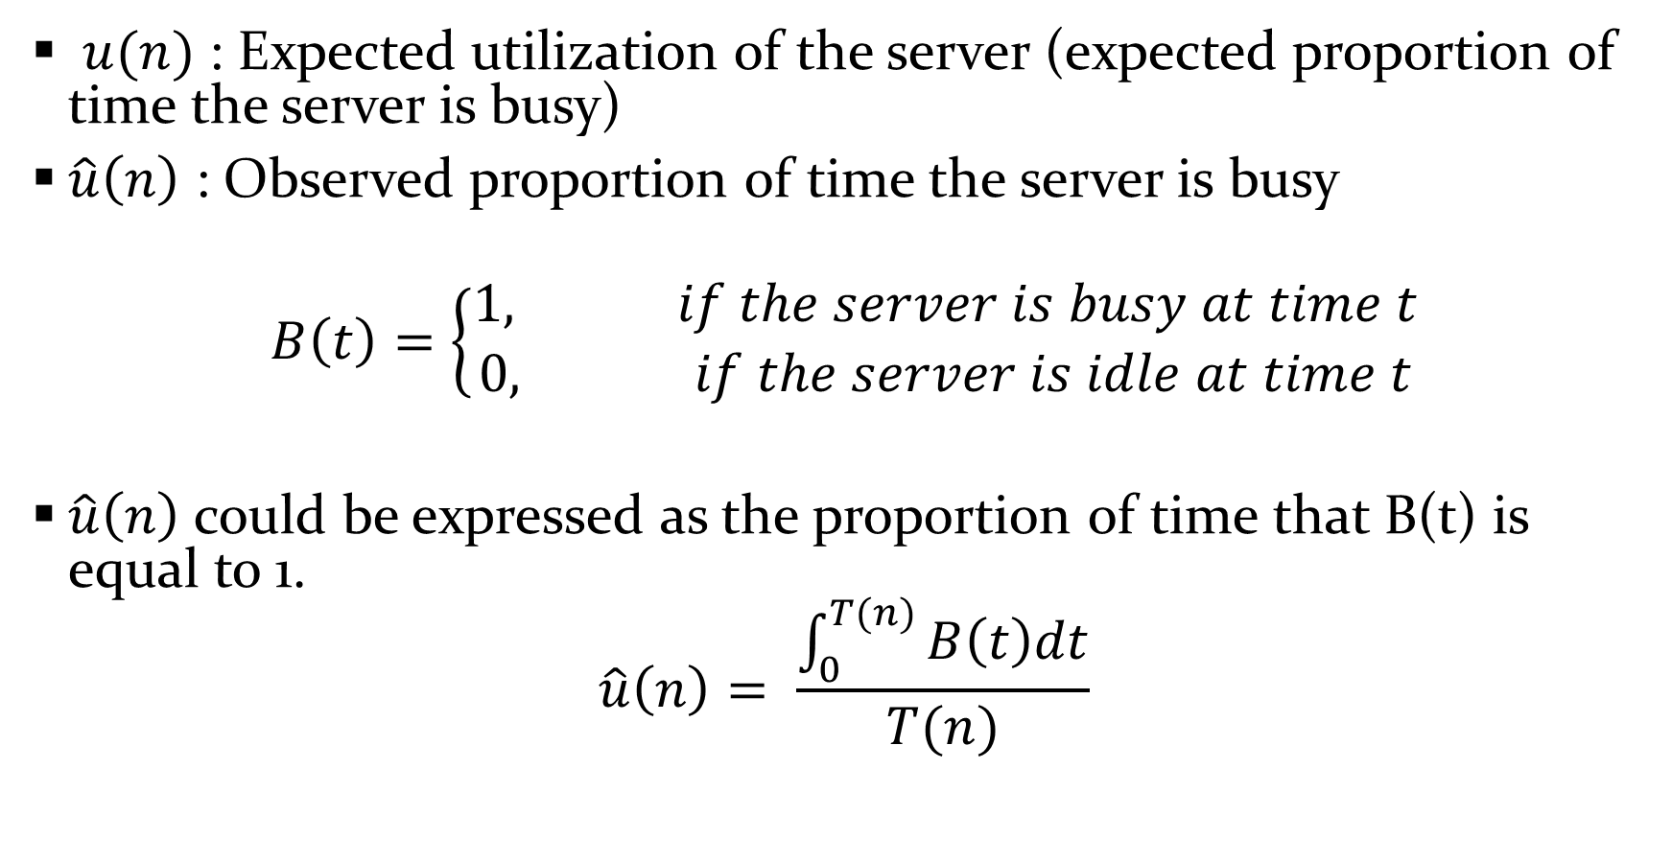
Expected Utilization of the server
$u(n)$ : Expected utilization of the server (expected proportion of time the server is busy)
$\hat{u}\left(n\right)$ : Observed proportion of time the server is busy
$$B\left(t\right)=\left\{\begin{aligned}1, if the server is busy at time t \\ 0, if the server is idle at time t\end{aligned}\right.$$
$\hat{u}\left(n\right)$ could be expressed as the proportion of time that B(t) is equal to 1.
$$\hat{u}\left(n\right)= \frac{\int_{0}^{T(n)}{B\left(t\right)dt}}{T(n)}$$

Slide 30
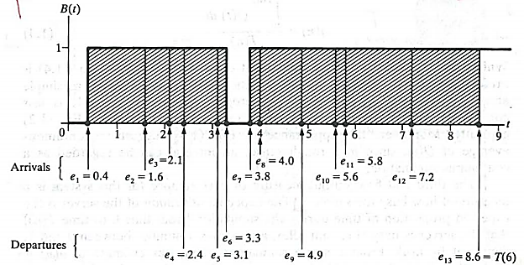

Expected Utilization of the server
Consider the following simulation run

Slide 31
Continuous and Discrete Time Statistics
Discrete Time Statistics
Average delay in the queue
Continuous Time Statistics
Average number of customers in the queue
Expected server utilization

Slide 32
SIMULATION OF A SINGLE-SERVER QUEUEING SYSTEM
Arrival of a customer
if server is idle then
-s/he enters service immediately
-his/her service time is calculated
else
-s/he joins the end of the queue
Departure of a customer
if queue is non-empty then
-server allows the first customer to go for the service (FIFO manner)
-his/her service time in calculated
else
-server remains idle

Slide 33
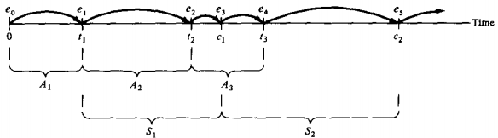
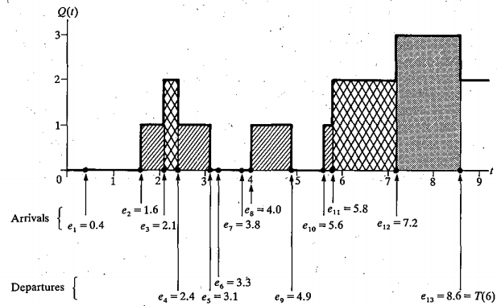
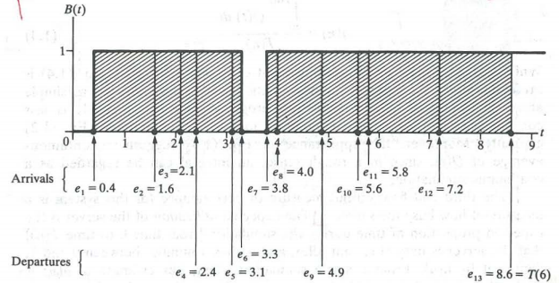

Slide 34
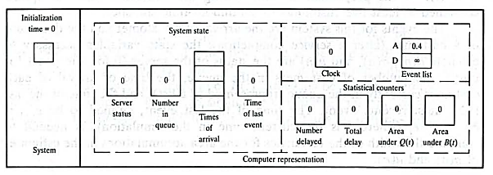

Slide 35
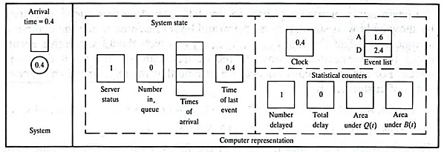

Slide 38
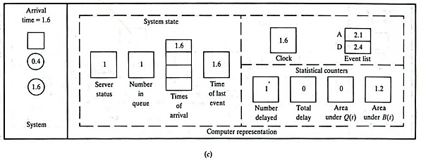

Slide 39
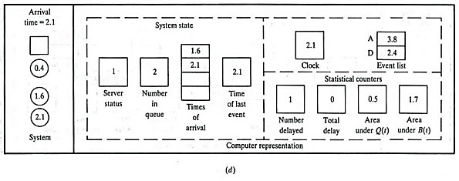

Slide 40
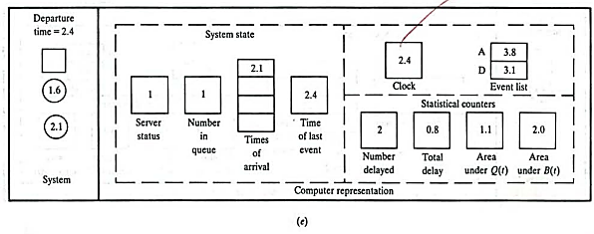

Slide 41
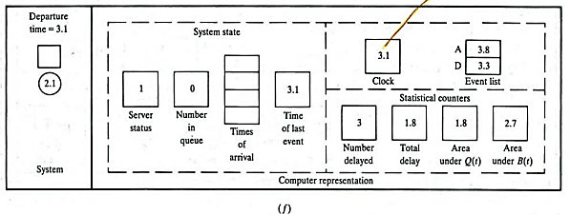

Slide 42
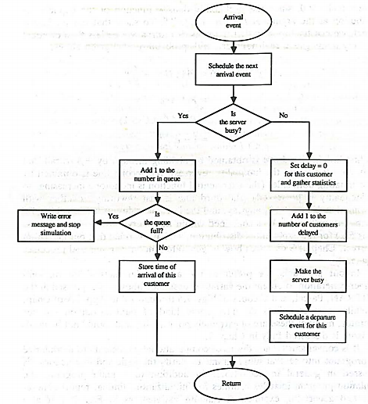
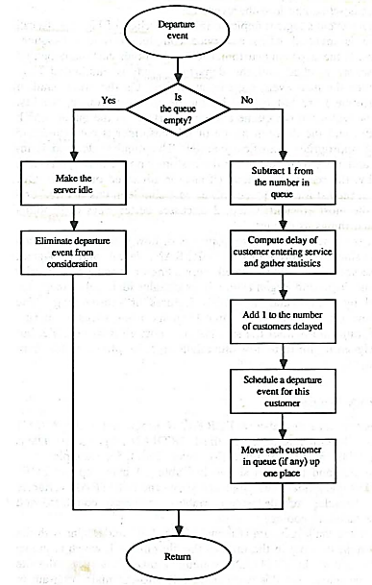

Slide 43
Home Task
Implement the full C Program given in 1.4.4
Give its name “YourStudentID_Original.c”
Change the code for fixed time end
Give its name “YourStudentID_FixedTimeEnd.c”
Make a folder named “YourStudentID”, zip and upload it

Slide 44
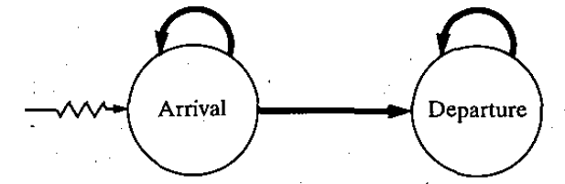
Different Issues
Inter-arrival and service time generation using random variates
Waiting time in the system vs waiting time in the queue
Event determination through event graph

Slide 45


Event determination through Event Graph
Thin jagged arrow: End event is scheduled initially
Heavy smooth arrow: End event may be scheduled from beginning event non-zero amount of time
Thin smooth arrow: End event potentially scheduled from beginning event without any intervening time

Slide 46
Event determination through Event Graph
The Event graph for single server queuing system

Slide 47
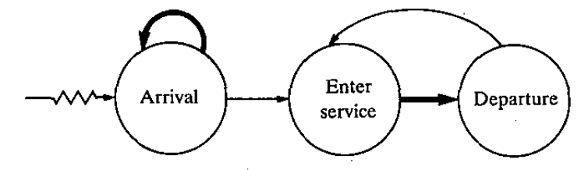
Event determination through Event Graph
Same system with an alternative event graph

Slide 48
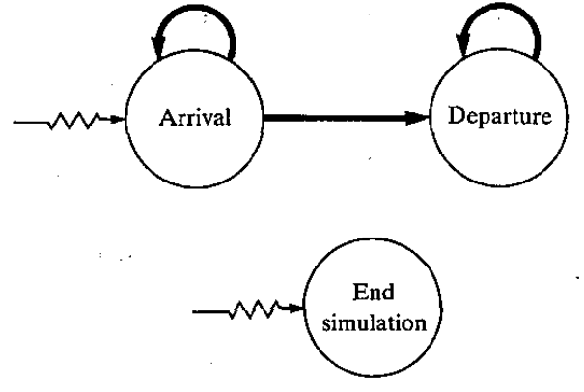
Event determination through Event Graph
Event graph for the same system using fixed time end
Initialization rule: Decomposing into strongly connected components

Slide 49

SIMULATION OF AN INVENTORY SYSTEM

Slide 50
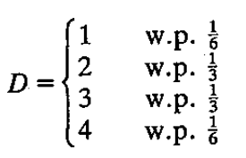
Problem Statement
Simulation for a company for next n months
Times between demands – IID exponential random variables (with a mean of 0.1 month)
Sizes of demands, D – IID random variables
Order cost = K+iZ
K is the setup cost, i is per item variable cost, Z is the number of items ordered
If Z = 0, then Order cost= 0

Slide 51
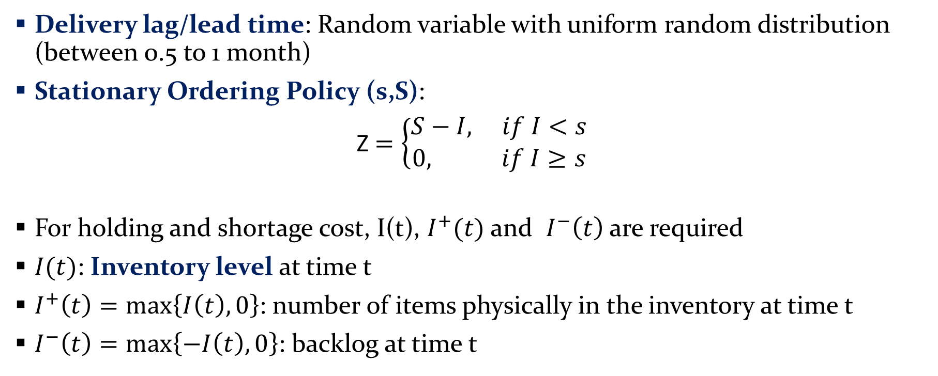
Problem Statement
Delivery lag/lead time: Random variable with uniform random distribution (between 0.5 to 1 month)
Stationary Ordering Policy (s,S):
Z $=\left\{\begin{aligned}S−I, if I<s \\ &0, if I≥s\end{aligned}\right.$
For holding and shortage cost, I(t), $I^{+}(t)$ and $I^{−}\left(t\right)$ are required
$I(t)$: Inventory level at time t
$I^{+}\left(t\right)=\max\left\{I\left(t\right),0\right\}$: number of items physically in the inventory at time t
$I^{−}\left(t\right)=\max\left\{−I\left(t\right),0\right\}$: backlog at time t

Slide 52
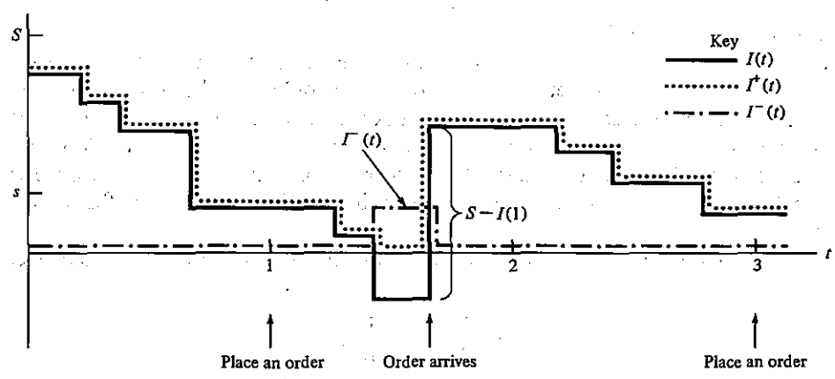
Problem Statement

Slide 53
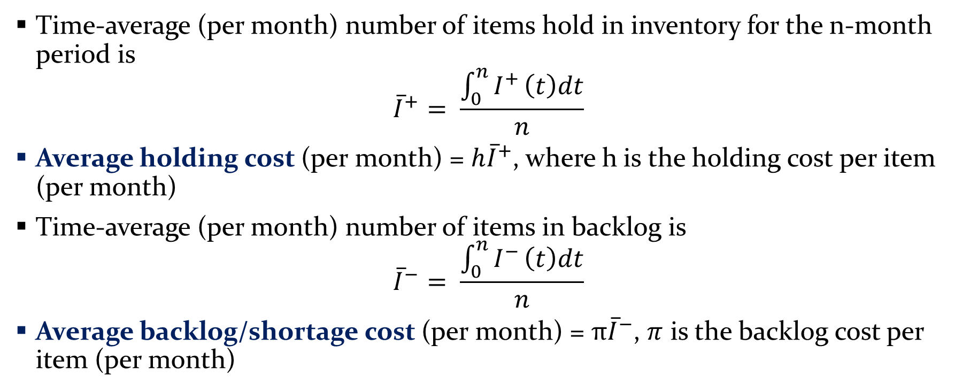
Problem Statement
Time-average (per month) number of items hold in inventory for the n-month period is
$${\overline{I}}^{+}= \frac{\int_{0}^{n}{I^{+}}\left(t\right)dt}{n}$$
Average holding cost (per month) = ${h\overline{I}}^{+}$, where h is the holding cost per item (per month)
Time-average (per month) number of items in backlog is
$${\overline{I}}^{−}= \frac{\int_{0}^{n}{I^{−}}\left(t\right)dt}{n}$$
Average backlog/shortage cost (per month) = $π{\overline{I}}^{−}$, $π$ is the backlog cost per item (per month)

Slide 54
Problem Statement
State Variables
Inventory level I(t)
Amount of an outstanding order (from the company to the supplier)
Time of the last event
Initially,
there is a certain inventory level, e.g., I(0) = 60
No order outstanding
Simulation is done
For a fixed time period, e.g., n = 120 months
To compute the total cost per month (ordering cost, holding cost and backlog/shortage cost) for different inventory policy (s,S)

Slide 55
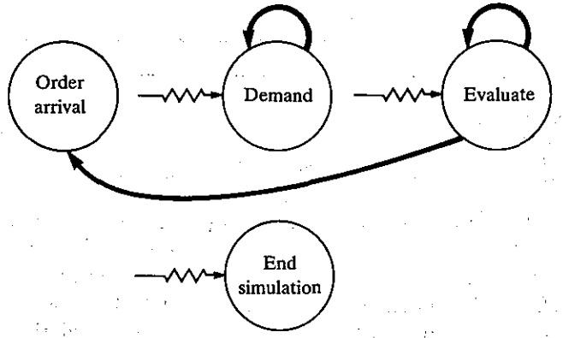
Event
Event Description | Event Type
Arrival of an order to the company from the supplier | 1
Demand for the product from a customer | 2
End of the simulation after n months | 3
Inventory evaluation (possibly ordering too) at the beginning of a month | 4
Ordering of Events is important.

Slide 56
Random Variates
Inter-demand times : IID exponential distribution
Demand-size, D: Random variate with
Delivery Lags: Uniform Distribution over interval [a,b]

Slide 57
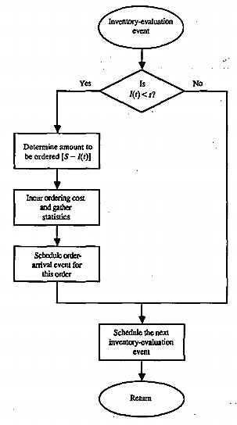
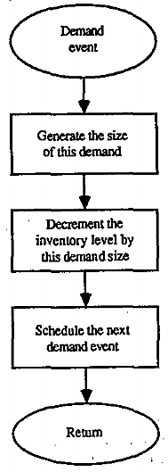
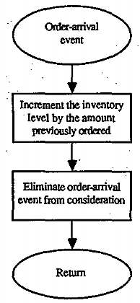
Flow Charts

Slide 58
STEPS IN A SOUND SIMULATION STUDY
Formulate the problem and plan the study
Collect data and define a model
Is the assumptions valid?
Construct a computer program and verify
Make pilot runs
Is the programmed model valid?
Design experiments
Make production runs
Analyze output data
Document, present and use results

Slide 59
Other Types of Simulation
Continuous Simulation
Combined Discrete-Continuous Simulation
Monte-Carlo Simulation
Spreadsheet Simulation

Slide 60
Continuous Simulation
State variables change continuously with respect to time
Generally involve differential equations that give relationships for the rate of change of the state variables with time
Analytical solutions are rare! Numerical solutions are used generally
Predator-prey model

Slide 61
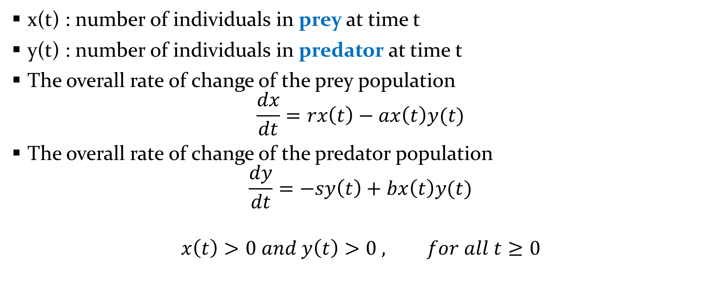
Predator-prey model
x(t) : number of individuals in prey at time t
y(t) : number of individuals in predator at time t
The overall rate of change of the prey population
$$\frac{dx}{dt}=rx\left(t\right)−ax\left(t\right)y(t)$$
The overall rate of change of the predator population
$$\frac{dy}{dt}=−sy\left(t\right)+bx\left(t\right)y(t)$$
$$x\left(t\right)>0 and y\left(t\right)>0 , for all t≥0$$

Slide 62
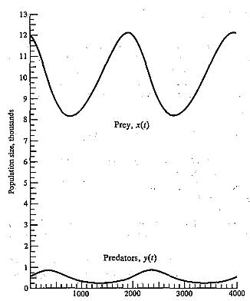
Predator-prey model
A sample figure for
a particular setting

Slide 63
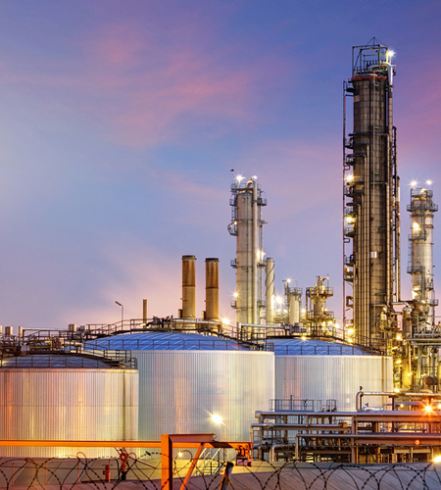
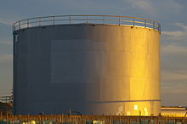
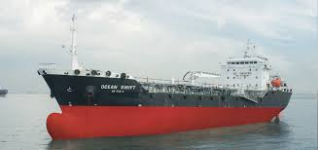
Combined Discrete-Continuous Simulation
Discrete change in continuous state variable caused by discrete event
Change in the relationship governing continuous state variable caused by a discrete event
Discrete event caused by a continuous state variable (achieving a threshold)
Tanker at a dock, Storage tank and Refinery

Slide 64
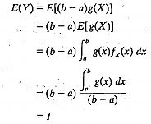
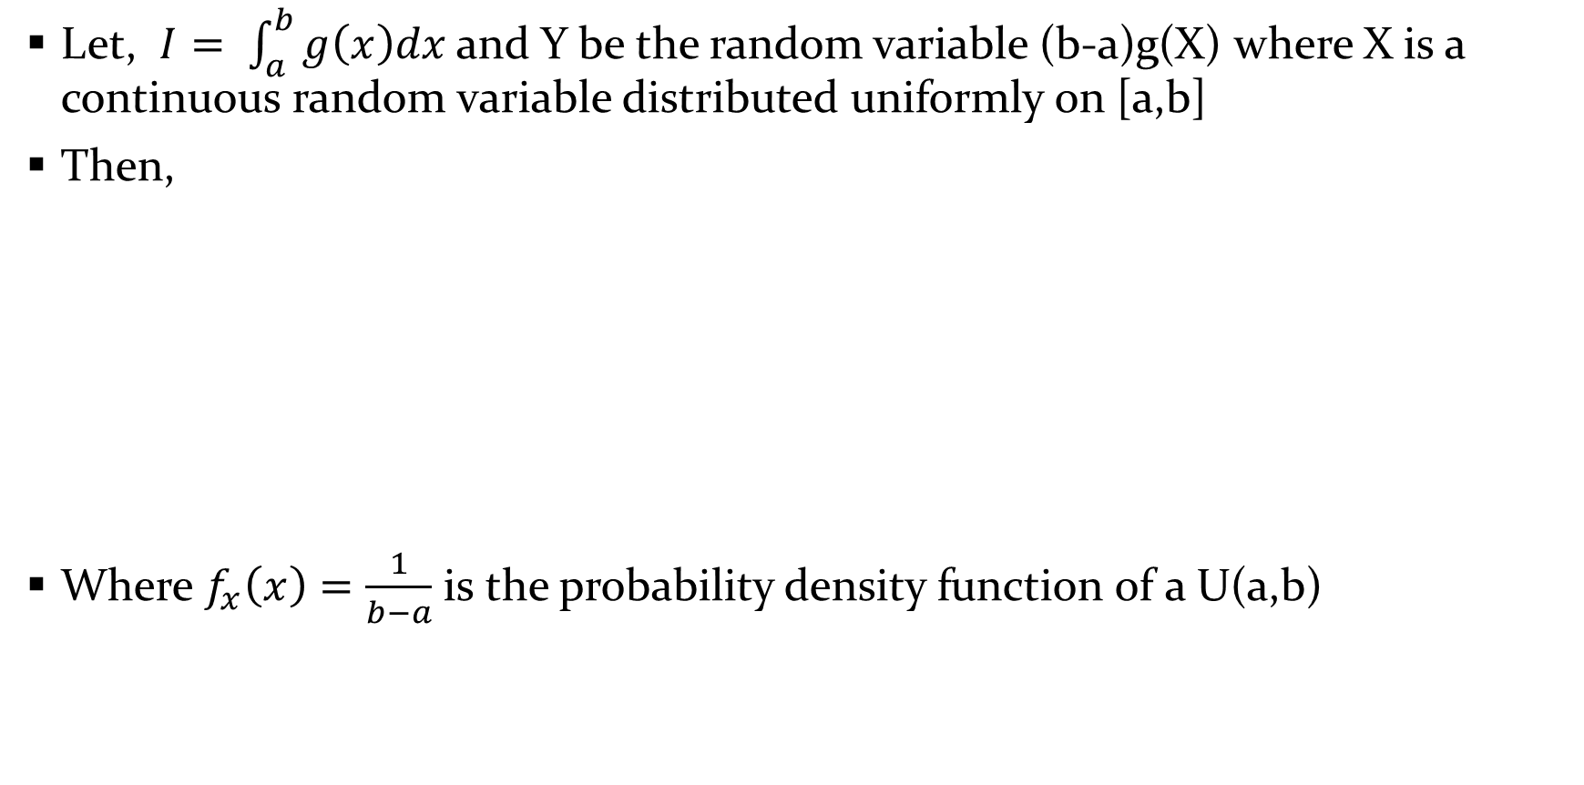
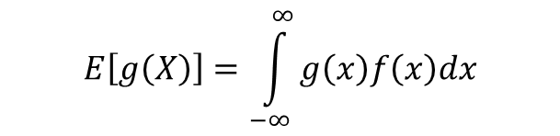
Monte-Carlo Simulation
Let, $I= \int_{a}^{b}{g\left(x\right)dx}$ and Y be the random variable (b-a)g(X) where X is a continuous random variable distributed uniformly on [a,b]
Then,
Where $f_{x}\left(x\right)=\frac{1}{b−a}$ is the probability density function of a U(a,b)
If X is a continuous random variable with probability density function f(x), then for any real-valued function g,
$$E\left[g\left(X\right)\right]=\int_{−∞}^{∞}{g\left(x\right)f\left(x\right)dx}$$

Slide 65
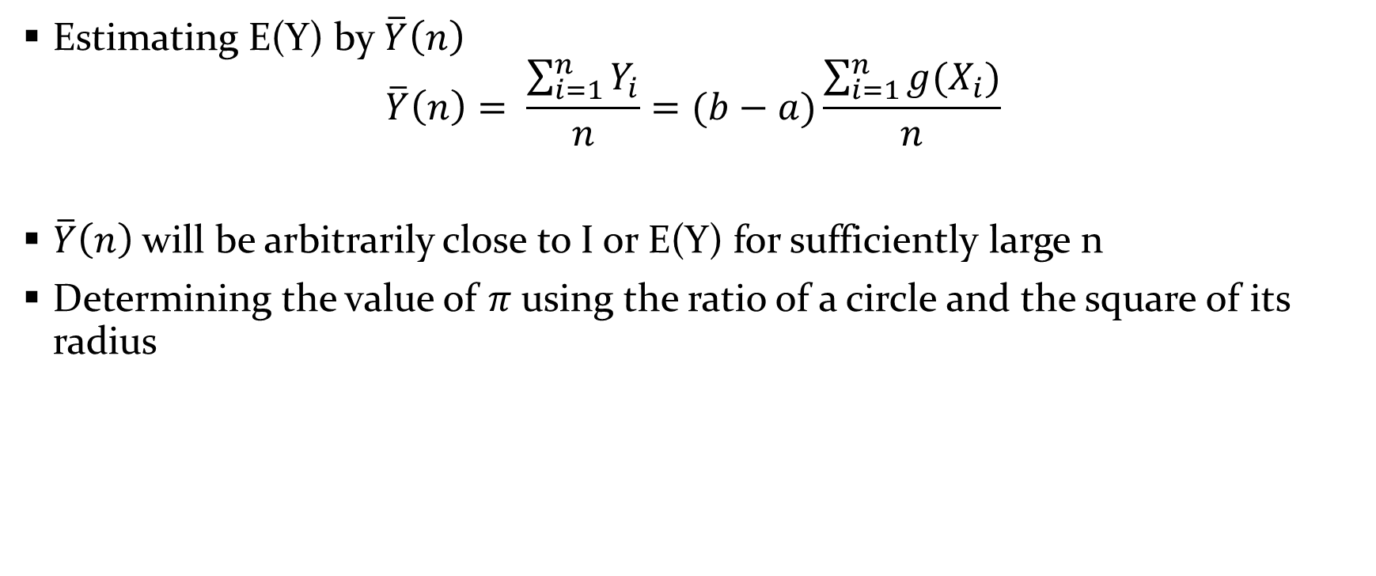
Monte-Carlo Simulation
Estimating E(Y) by $\overline{Y}\left(n\right)$
$$\overline{Y}\left(n\right)= \frac{\sum_{i=1}^{n}{Y_{i}}}{n}=(b−a)\frac{\sum_{i=1}^{n}{g(X_{i})}}{n}$$
$\overline{Y}\left(n\right)$ will be arbitrarily close to I or E(Y) for sufficiently large n
Determining the value of $π$using the ratio of a circle and the square of its radius

Slide 66
ADVANTAGES, DISADVANTAGES, AND PITFALLS OF SIMULATION
Read Section 1.9 of the reference book very carefully

Slide 67
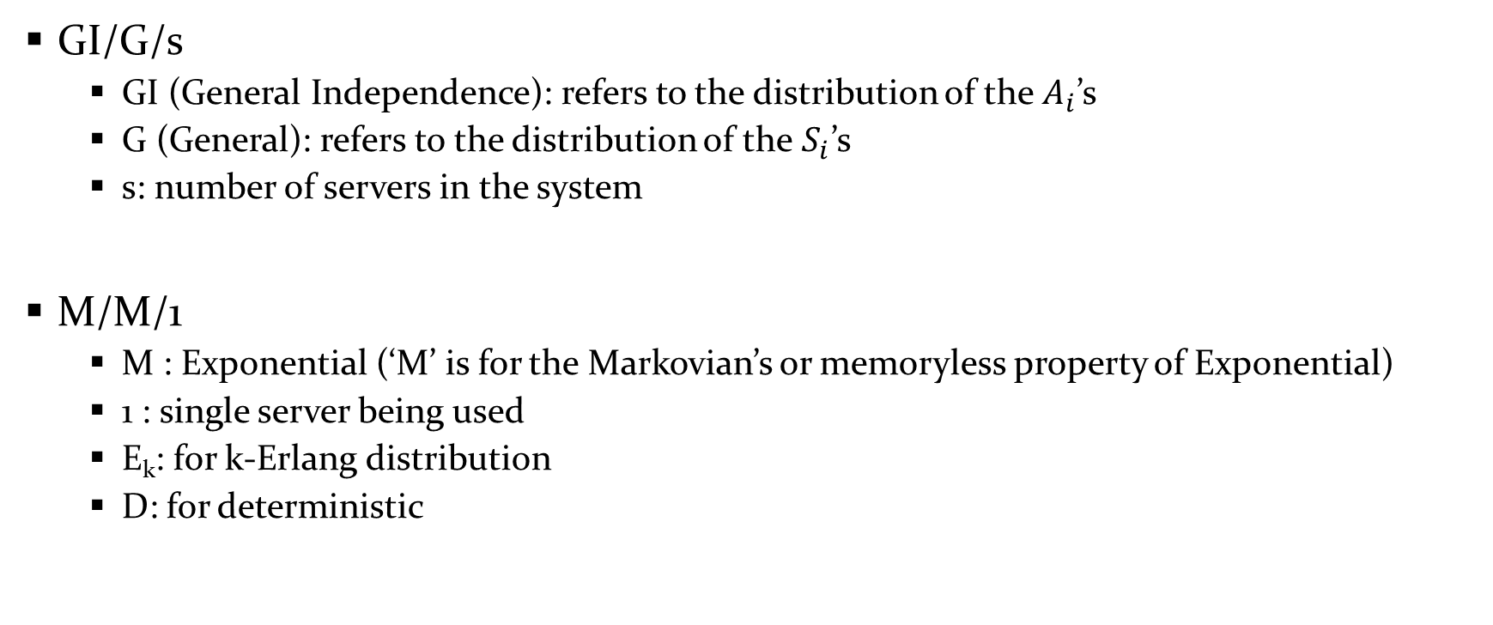
Queuing System
GI/G/s
GI (General Independence): refers to the distribution of the $A_{i}$’s
G (General): refers to the distribution of the $S_{i}$’s
s: number of servers in the system
M/M/1
M : Exponential (‘M’ is for the Markovian’s or memoryless property of Exponential)
1 : single server being used
E_{k}: for k-Erlang distribution
D: for deterministic

Slide 68

Performance Measure of a system
$$ρ= \frac{λ}{sω}$$
If E(A) is the mean of the distribution for inter-arrival time, then
$$λ=\frac{1}{E(A)}=arrival rate of customers$$
If E(S) is the mean of the distribution for service times, then
$$ω= \frac{1}{E(S)}=service rate of a server$$

Slide 69
Analytical Solution
We want to estimate, L, Q, w, d
d: steady-state average delay
w: steady-state average waiting time
Q: steady-state time-average number in queue
L: steady-state time-average number in system

Slide 70

Analytical Solution
Now for single server queuing system (where s=1),
$$ρ= \frac{λ}{ω}$$
Now if $ρ= \frac{λ}{ω}<1$, then
$$L= \frac{λ}{ω − λ}$$
$$Q= \frac{λ^{2}}{ω (ω−λ)}$$
$$w= \frac{1}{ω − λ}$$
$$d= \frac{λ}{ω(ω−λ)}$$

Slide 71
Reference
Simulation Modeling and Analysis by Averill M Law (Fourth Edition)
Chapter 1 (1.4, 1.5, 1.7, 1.8, 1.9 and Appendix 1B)

